Slide 1
tableau amazon.sid
File created on: 7/2/2024 1:50:21 AM

Slide 2
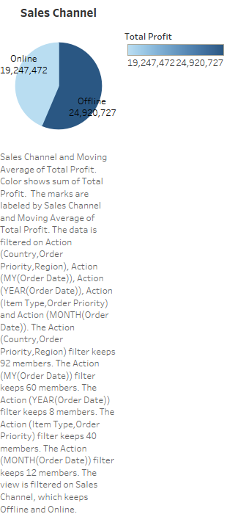

Slide 3
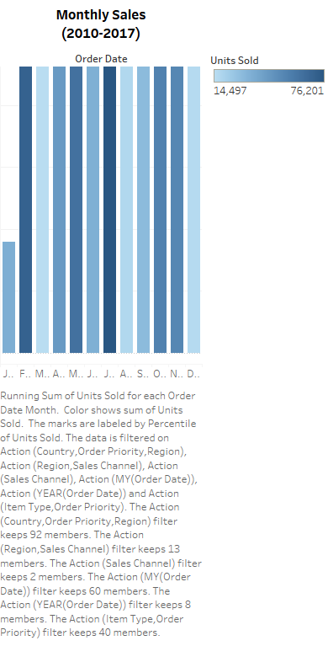

Slide 4


Slide 5
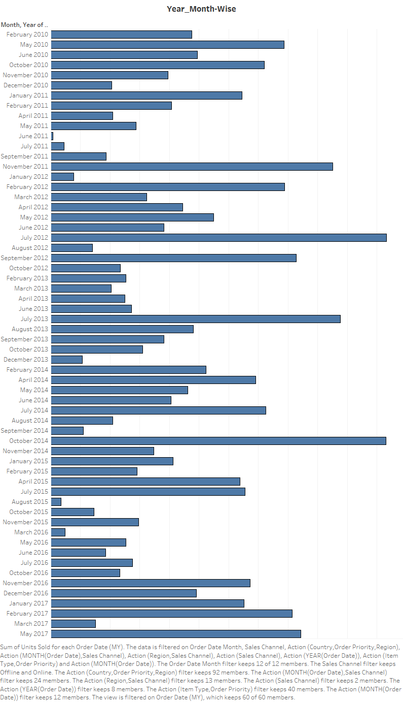

Slide 10


Slide 11
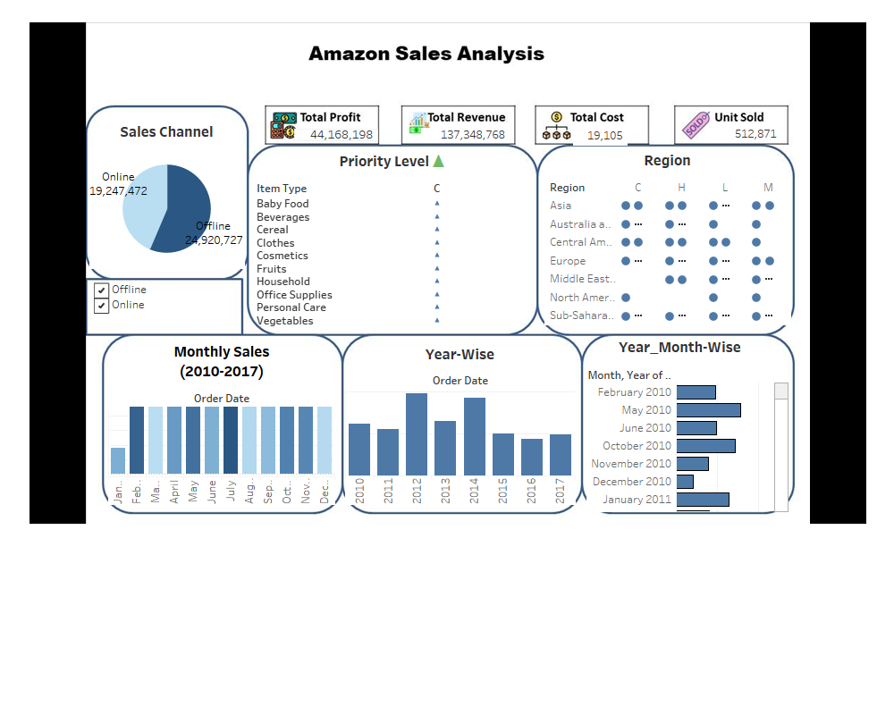

Slide 12
